Slide 1
Python Basics (Practice)
Jessica Randall, MPH
IBS 574 Spring 2020

Slide 2
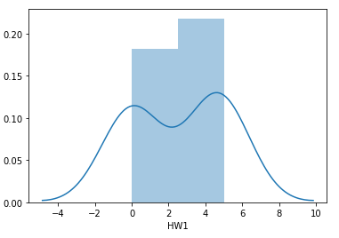
Check-in:
HW 1 Grade summary
Most people who submitted did really well
Some 404 errors
Some empty submissions

Slide 3
Video on PCA
Thoughts? Feelings? Questions?
How do we graph PCA plots using counts from more than 3 genes?
What does the distance between points on a PCA plot tell you about the relationships between the points?
May be more math than you’ll personally need but it’s important to recognize when you need to find more information or find someone who does

Slide 4
Recap
Last class:
Talking about coding
This class:
Coding
Next class:
Computer Lab

Slide 5
Before you start a project
You’re teaching a computer
Use a workflow to start or draft a new one
Biopython or Bioconductor
Pseudocode

Slide 6
In-class practice: pseudocode preparation for a PCA plot
Import numpy, sklearn, seaborn
Counts = matrix of counts
Sampledata = table of sample data
Scaledcounts = scale(counts)
pca = PCA(n_components = 2)
Combine PCs with target data

Slide 7
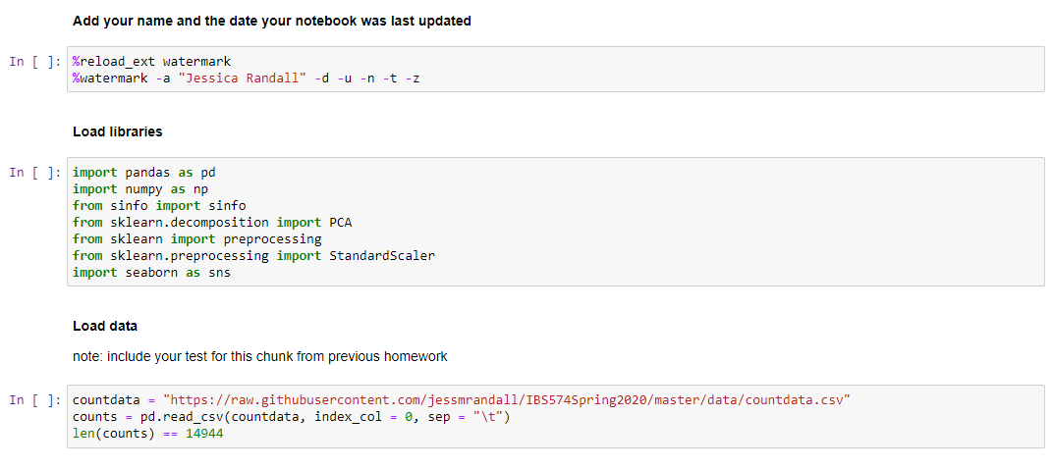
Peters, 2004

Slide 8
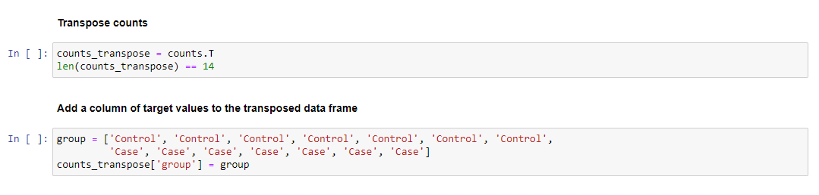
Peters, 2004

Slide 9
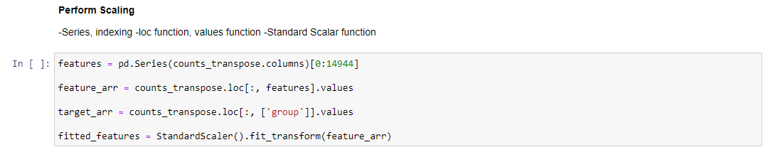
PCA maximizes the variance in the features along the axes
We should standardize to compare the features since library sizes may vary
Peters, 2004

Slide 10
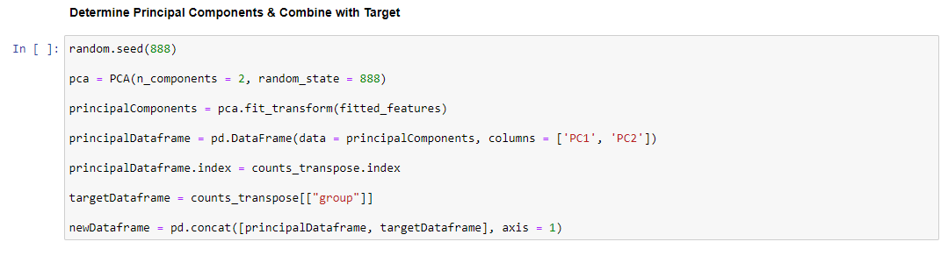
PCA reduces dimensionality > many genes to most important numerical parts of genes
Not going to discuss eigenvalues and eigenvectors as this tends to make eyes glaze over
For a thorough explanation see slide 14
Note that your seed can be any integer you like

Slide 11
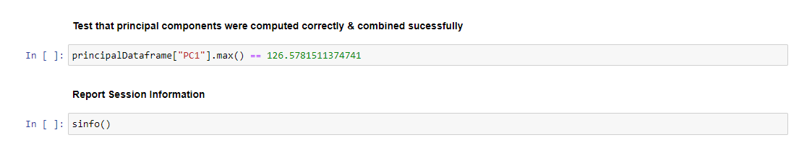
Peters, 2004

Slide 12
Next class: Computer Lab (Practical)
Calculate explained variance (Next week)
Practice making and interpreting PCA plots

Slide 13
Homework
HW 2 due next Tuesday

Slide 14
If curious
PCA in 3 Easy steps by Sebastian Raschka

Slide 15
Resources & References
https://sebastianraschka.com/Articles/2015_pca_in_3_steps.html
https://www.kindsonthegenius.com/2019/01/12/principal-components-analysispca-in-python-step-by-step/
https://scikit-learn.org/stable/modules/generated/sklearn.decomposition.PCA.html
http://www.datasciencemadesimple.com/get-maximum-value-column-python-pandas/
https://pandas.pydata.org/pandas-docs/stable/index.html

